Slide 1
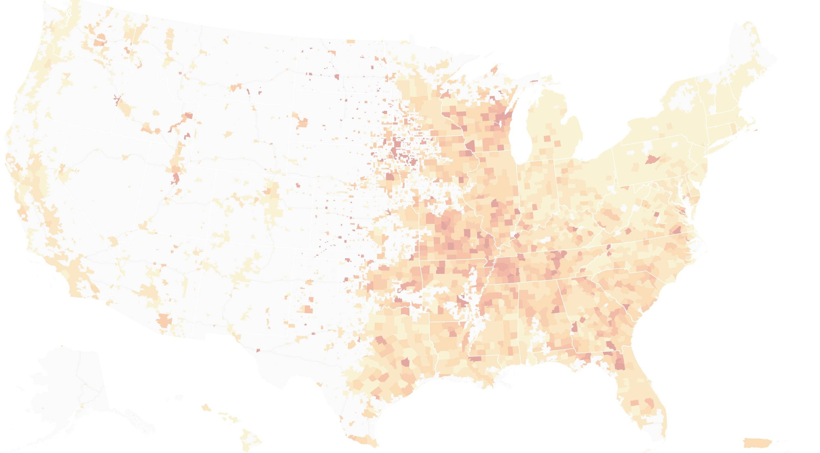
Mobility Under Covid-19
-------- New York City
OvernightHackers

Slide 2
0. Introduction
COVID-19 pandemic has been quickly spreading all over the world.
New York City is the MOST affected city around the globe
NY Gov. Cuomo passed several strict policies reacting to the pandemic
Questions:
Is the actual scenario close to expectation?
How much did people carry out the quarantine policy?
To what extent is people’s transportation affected during quarantine?

Slide 3
By analyzing data of different transportation in NYC!
(In a timely manner...)

Slide 4
Key Timeline in NYC
March 7, 2020 - Governor Cuomo declares a state of emergency
March 12, 2020 - Events with more than 500 people must be cancelled or postponed
March 17, 2020 - NYC bars and restaurants close, except for delivery
March 22, 2020 - NYS on Pause Program begins, all non-essential workers must stay home
March 28, 2020 - Governor Cuomo halts all nonessential construction sites in NYS
April 15, 2020 - Governor Cuomo requires face masks or coverings in public places
June 8, 2020 - NYC begins Phase 1 reopening
June 22, 2020 - NYC begins phase 2 of reopening
July 6, 2020 - NYC begins Phase 3 of reopening, without indoor dining
July 19, 2020 - NYC begins Phase 4 reopening, excluding malls, museums and indoor dining/bars
Reference: https://www.investopedia.com/historical-timeline-of-covid-19-in-new-york-city-5071986

Slide 5
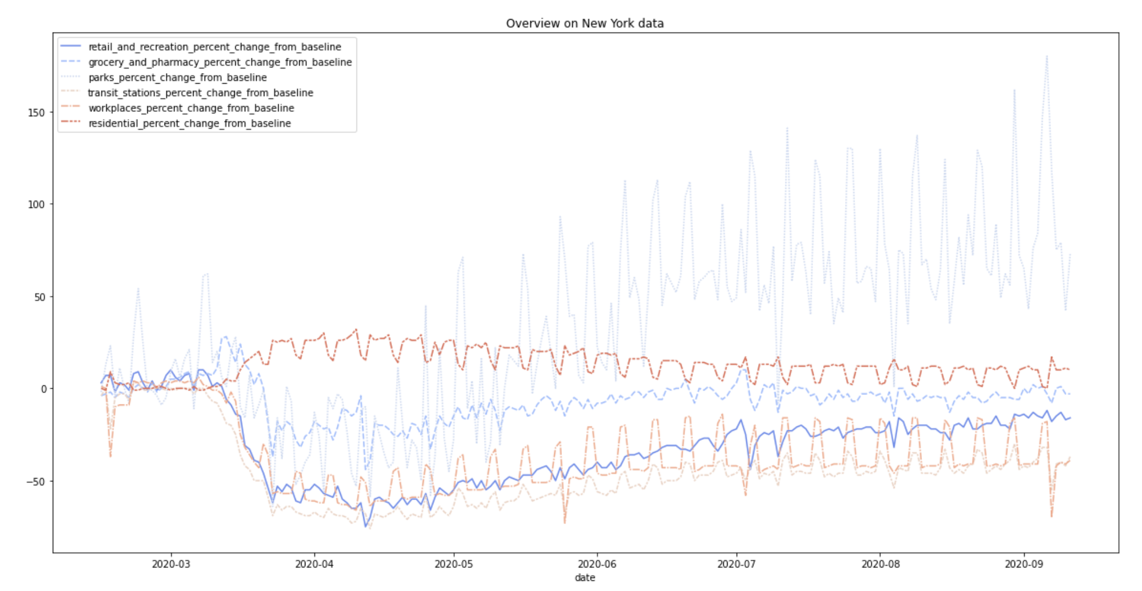
An Overview
Mar.20

Slide 6
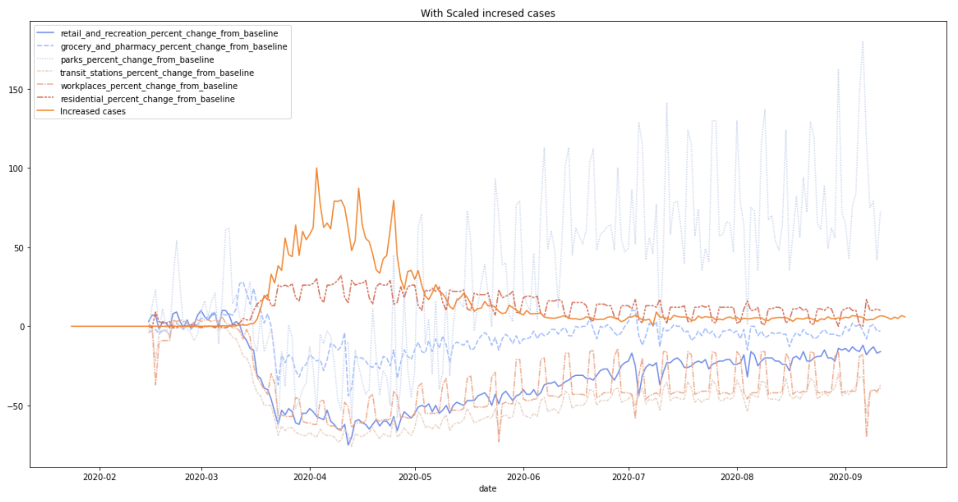
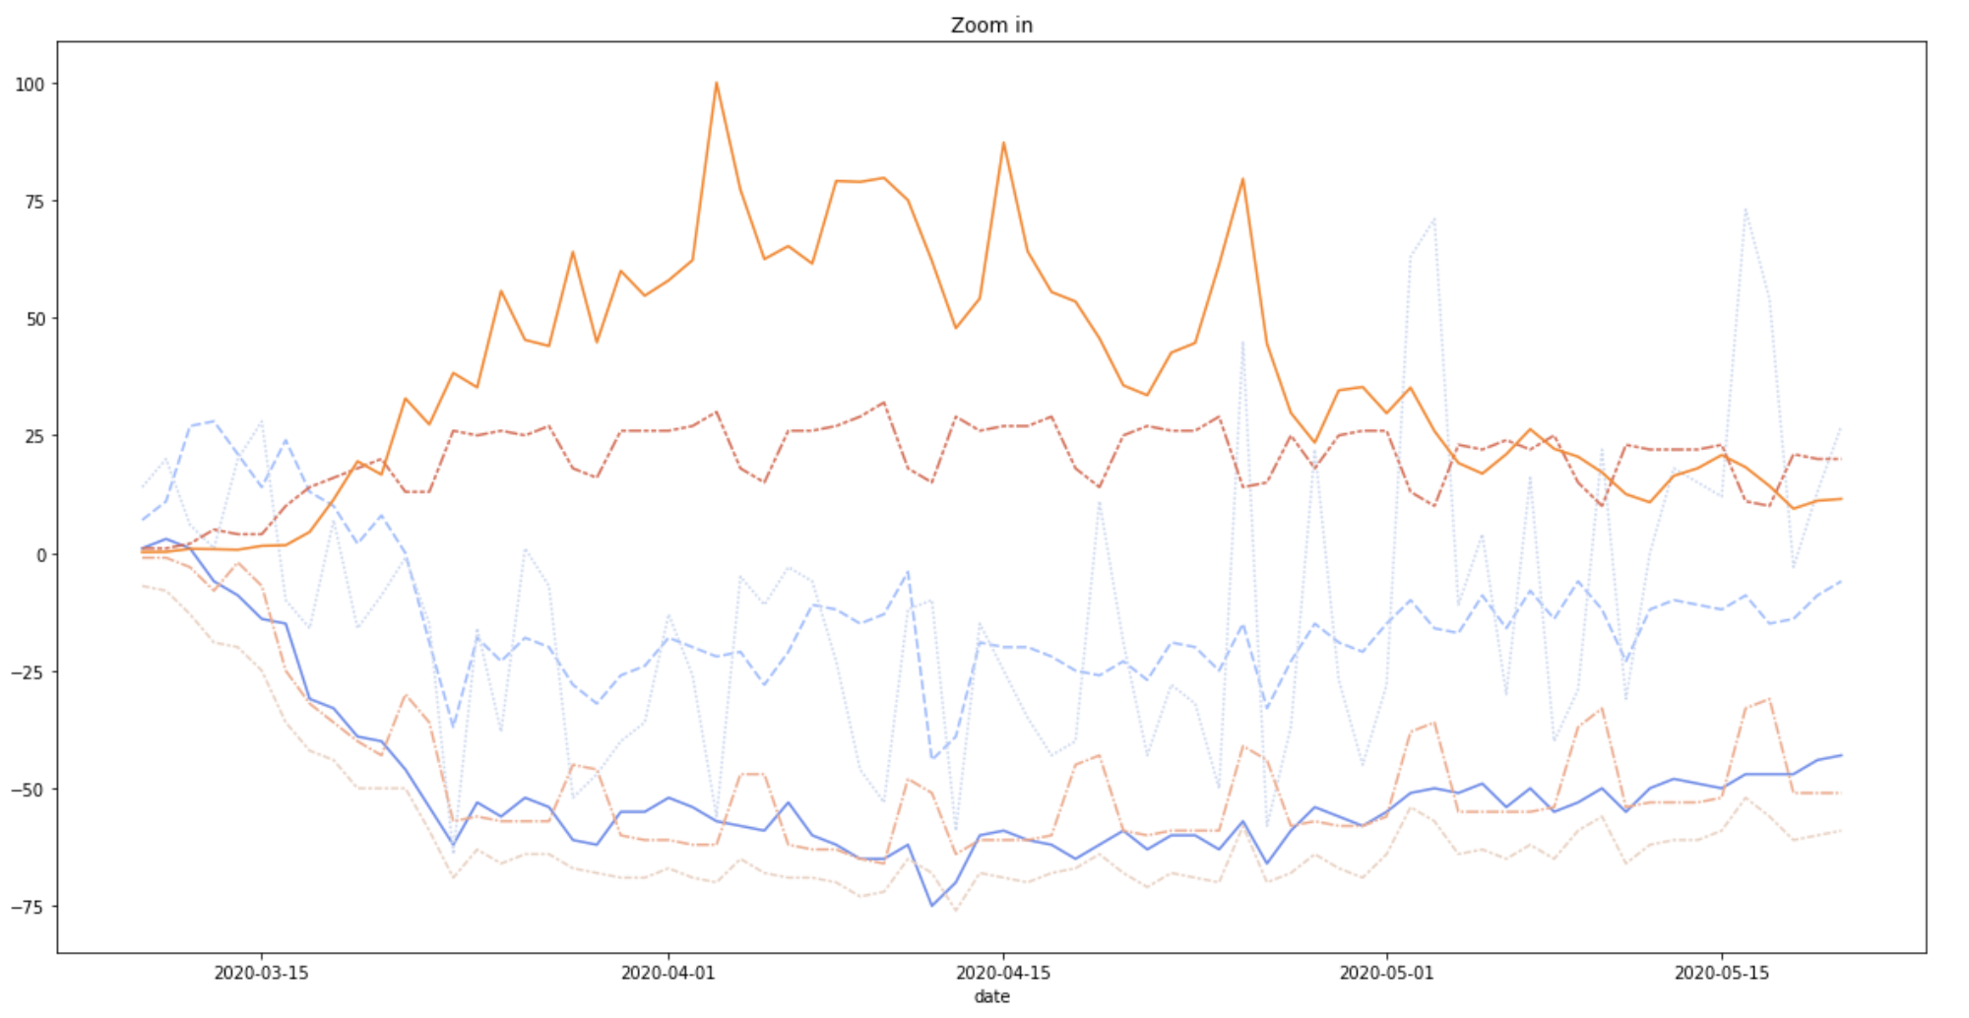
Compared with increasing cases

Slide 7
Airport Traffic Analysis
Three major airports around NYC
John F. Kennedy International
Newark Liberty International
LaGuardia
Weekday data says most!
Most personal flights during weekends
No much impact
Business trips choose weekdays
Very much impact due to WFH policy
No more business trips!

Slide 8
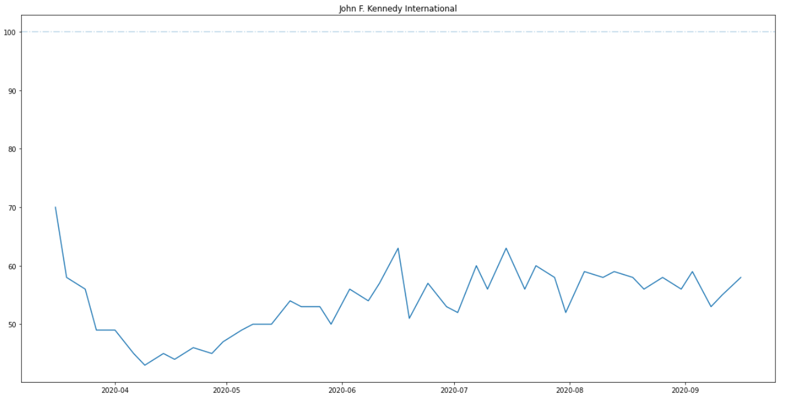
John F. Kennedy International Airport
Quick drop to 40% service 1 month after the quarantine
Gradually Increase to around 55% and stays there afterwards

Slide 9
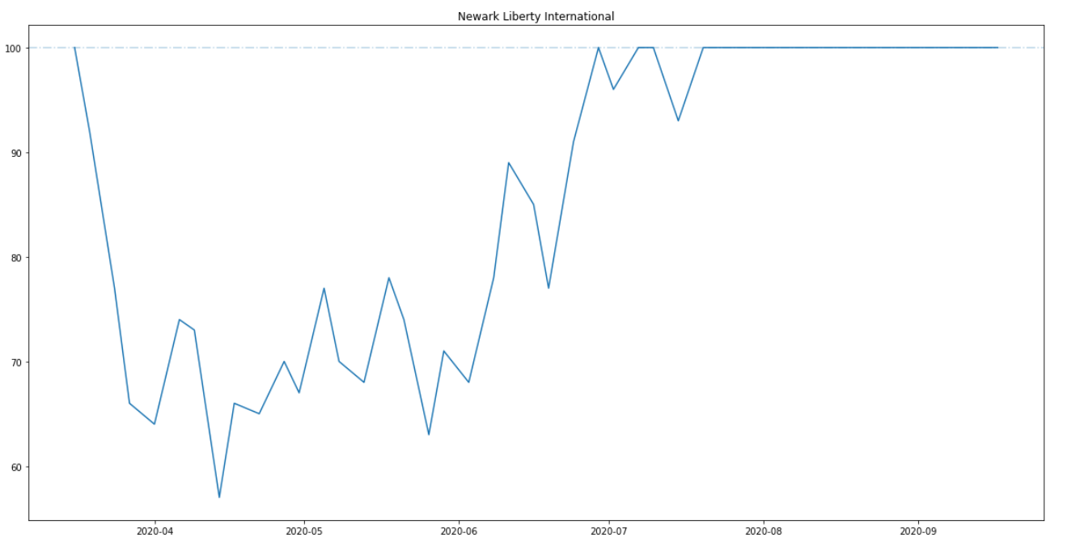
Newark Liberty International Airport
Not much decrease ever from the start
Gradually grow back to normal usage in a month
Reached 100% usage after July
100% Usage!!

Slide 10
Possible Explanations of Newark’s Case
Even though Newark is a major airport of NYC, it’s still located in Jersey City, which is why the operation of the airport itself is NOT under the control of Gov. Cuomo.
More EU airlines land at JFK than at Newark.
For example, Italy, France were heavily impacted by the pandemic during spring and early summer.
Both Air France and Air Italy only land at JFK.
China Travel-ban
Almost all Chinese airlines land at JFK, which causes the recovery of JFK’s usage become much slower than that of Newark.

Slide 11
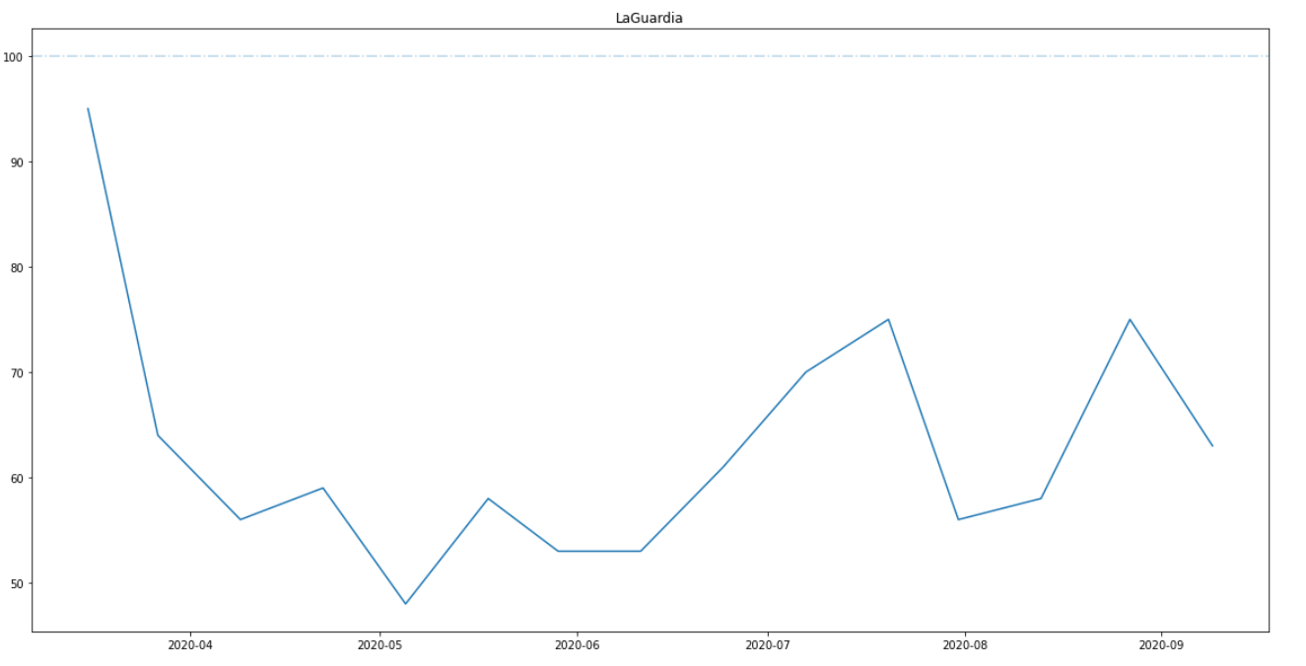
LaGuardia
Very quick decrease of usage right after the quarantine
Restored to around 70% of usage in July and bouncing between 60% and 80%

Slide 12
Short Conclusion
In general, the usage of airline transportation decreases quickly right after Gov. Cuomo’s WFH and quarantine policies, meaning people travels much less by air than before
International flights contributed more to the ‘decrease of usage’ than domestic flights, meaning relatively people tend to take more domestic flights than international flights during the pandemic.
National Policies prevents people from taking international flights
Due to the WFH order, many people take domestic flights to vacation houses or original home for work around March/April
Cheap airlines/small airline companies tend to suffer much more loss than larger ones (More such airlines land at LaGuardia, but LaGuardia never restored to more than 80% usage just as Newark did)

Slide 13
2. Road Congestion Analysis
Different time periods throughout the day are considered separately.
Morning rush hours (7AM)
Working hours (1PM)
Evening rush hours (4PM)
Weekday and Weekend data says differently!
Surprisingly, there is no significant decrease in road congestion on weekend during quarantine!
More clearer pattern in weekday data as expected.

Slide 14
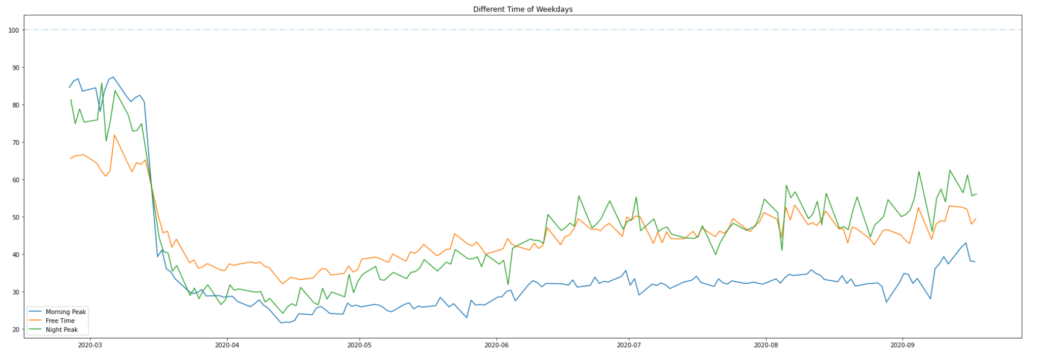
Weekday Data Plot
Start of Lockdown order

Slide 15
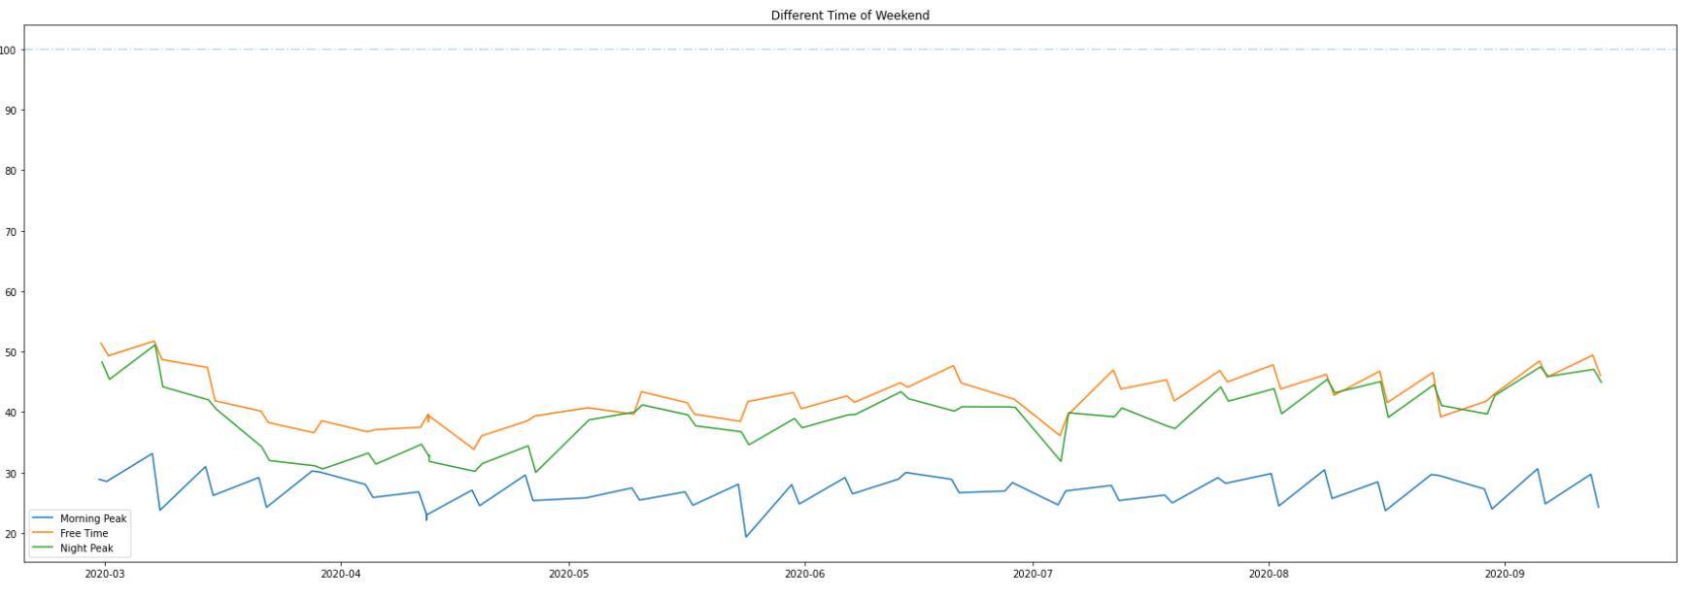
Weekend Data Plot

Slide 16
Possible Explanations
Even though Gov. Cuomo halted non-essential onsite work near the end of March, it seems that the clear decrease of road congestion starts at the beginning of March. This implies an interesting fact that people’s awareness of the pandemic raised before government’s orders.
At the starting phase of quarantine, both morning rush hour congestion and evening rush hour congestion dropped dramatically, but obviously morning hour congestion is impacted more.

Slide 17
Possible Explanations (continued)
We may conclude a general fact: not just congestion is less severe, but people’s life routines actually changed:
Morning rush hour road traffic decreases most, and stays at that low level, while evening rush hour congestion decreases less, but more importantly recovers to a decent amount.
At later phase of the diagram, we notice that the curves of evening rush hour traffic and working hour traffic become indiscriminable, implying that the boundary between strict working time and free time is diminished.
Morning rush hour traffic decrease the most may be due to it consists a highest percentage of people commute to work among all time periods. Unlike evening rush hour, the morning rush hour road congestion never restore back because the still-effective order of WFH in non-essential industries.

Slide 18
Possible Explanations (continued)
We may notice that for weekends, there is only a slight change in all three curves. This also proves our point that WFH policy mostly impacts work mobility.

Slide 19
3. Public Transit Stations Passenger Flow
In our opinion, the pandemic would affect people’s choice of public transportation most.
We use the passenger flow in large transit stations as a measurement.

Slide 20
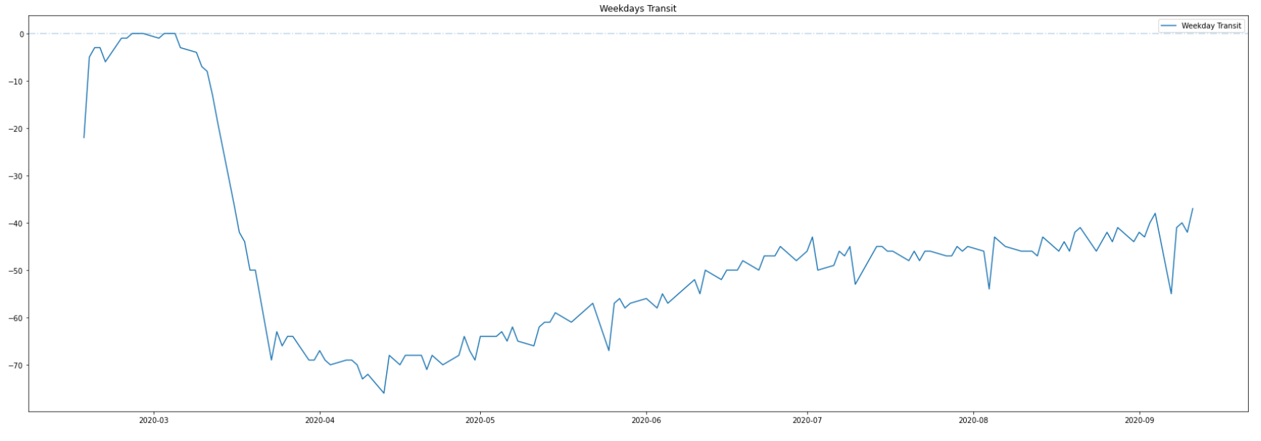
Weekday Transit Plot

Slide 21
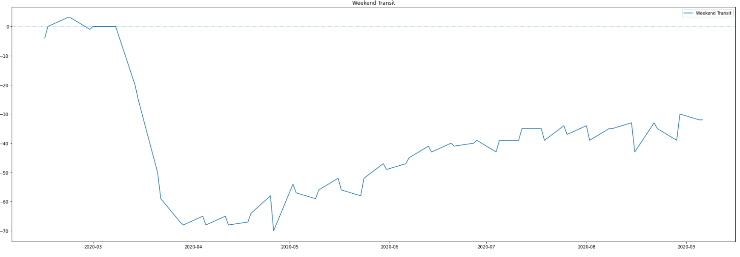
Weekend Transit Plot

Slide 22
Possible Explanation
Unlike private transportation (reflected in road congestion), public transportation seems to follow the same trend on weekdays and weekends.
It is very likely that people just generally ‘fears’ transportation, due to potential high-risk and closed environment.

Slide 23
4. Different Vehicle Usage Analysis
Besides the measurements we just applied for private transportation and public transportation, we would like to show a horizontal comparison using another metric: fuel refills.
Our hidden assumption is that: the more times a car owner refills, the more he drives/uses the car (which is rational)

Slide 24
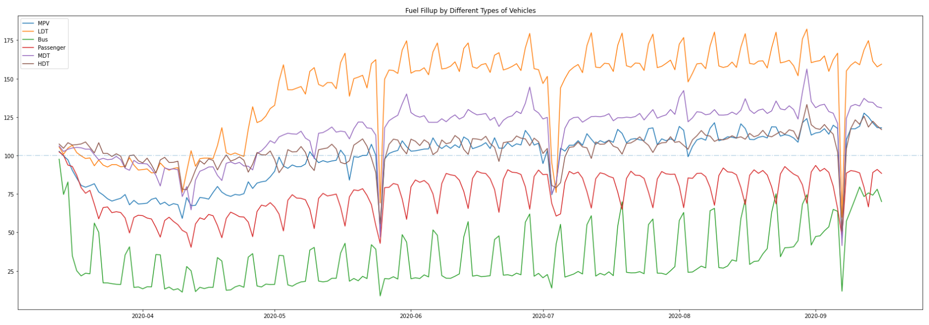
The name is Plot, LE PLOT...

Slide 25
Possible Explanations
Only one vehicle’s usage is WAY ABOVE baseline: Light-Duty-Trucks. This is heavily connected to people’s reduced mobility: life essentials rely on delivery services (including but not limited to: Amazon, Instacart, etc.)
The usage pattern of LDT and Bus are exactly the same, while surprisingly contrary to the usage pattern of other private-usage vehicles. Possible reason: The places that people used to hangout on weekends (like shopping malls) are no longer open. Hence the affiliated parking lots are also closed, leading to lack of parking places. So on weekend people choose public transportation more than weekdays.

Slide 26
Possible Explanations (Continued)
Due to lack of space in the last slide, we make amendments to our last conclusion here. We were talking about the reason that causes the pattern, but in general, usage of bus transportation still dropped by more than 50%, even on weekends.

Slide 27
Discussion
When processing the dataset, we noticed some common outliers among all datasets:
Independence Day
Labor Day
Memorial Day
To better present the data, we removed those obvious outliers from the dataset.

Slide 28
Looking in to the future...
Due to shortage of time, we have some great ideas that didn’t have time to present:
Use regression models to predict approximate time when our life will be back to normal… (definitely will be interesting)
Obtain more potential features such as:
Public transportation occupation rate
Bike share
Commercial usage of vehicles

Slide 29
FINAL Conclusion
Pandemic changed people’s mobility in many different ways. The most impact we found is the WFH order. This may change our way of work and life for longer than we thought… Besides, the pandemic also changes people’s choice of transportation method, leading to more general and broader life choices.
Only time will tell...

Slide 30
Final Answer to the Proposed Problem of the Hackathon:
…...

Slide 31
42

Slide 32
Thanks!

